Slide 1
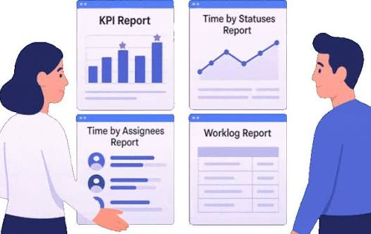

Data to Decisions

Slide 2
Mission
Practical Minds + Carrer Reediness
Measurable Business Decision
Super 50
Nilaya Education Group
Transformation
Data Analytics Skills

Slide 3

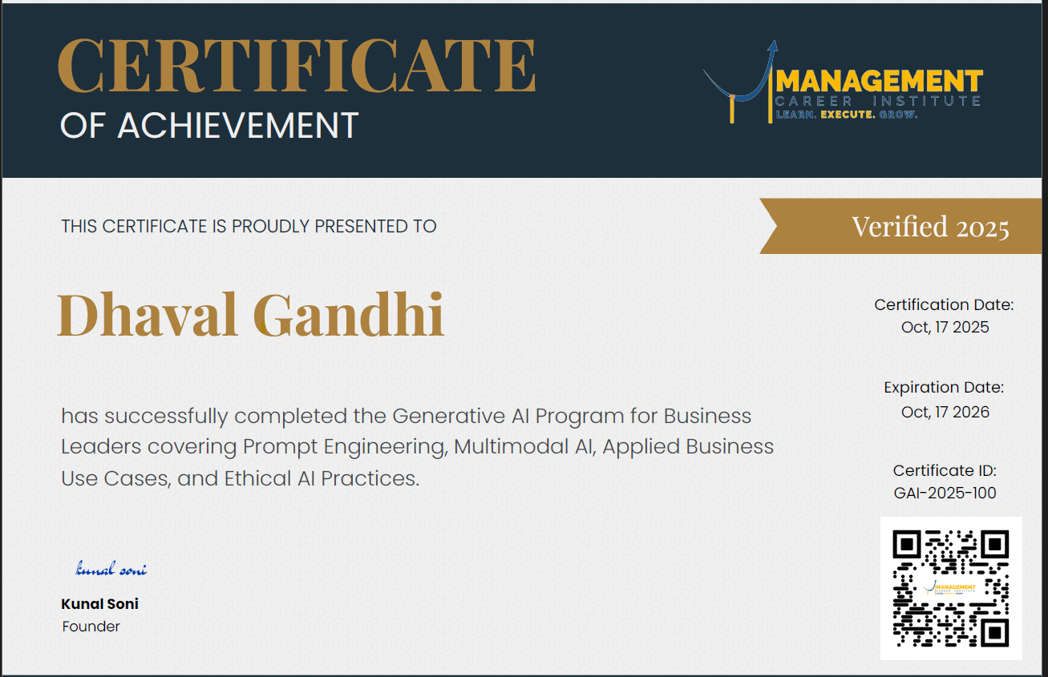

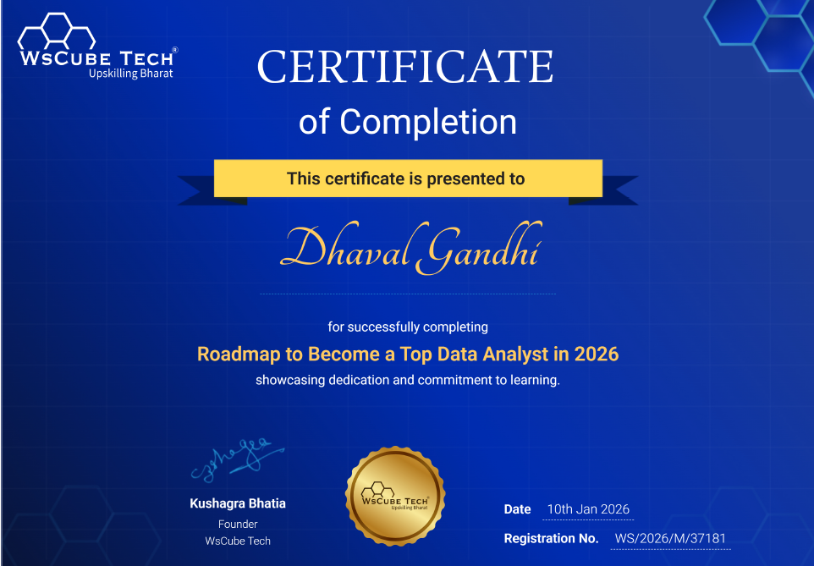

IT Professional
Data Analytics, AI & Blockchain Trainer
Marathon, Triathlon & Duathlon Athelete

Slide 4






Have you seen this today?

Slide 5
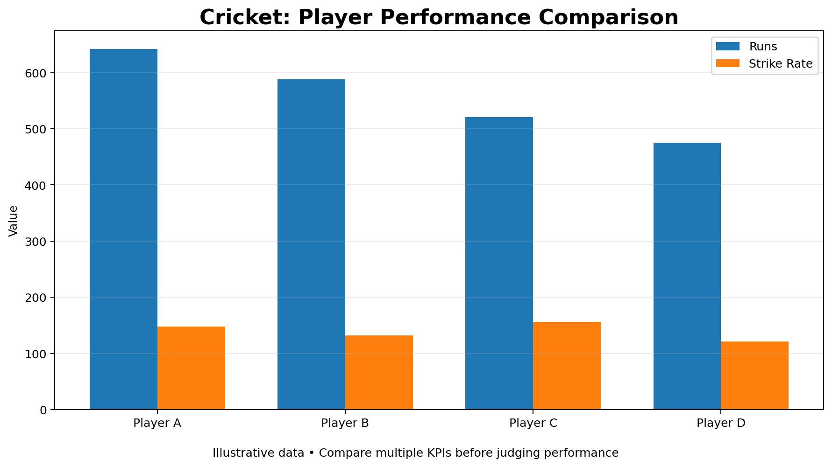
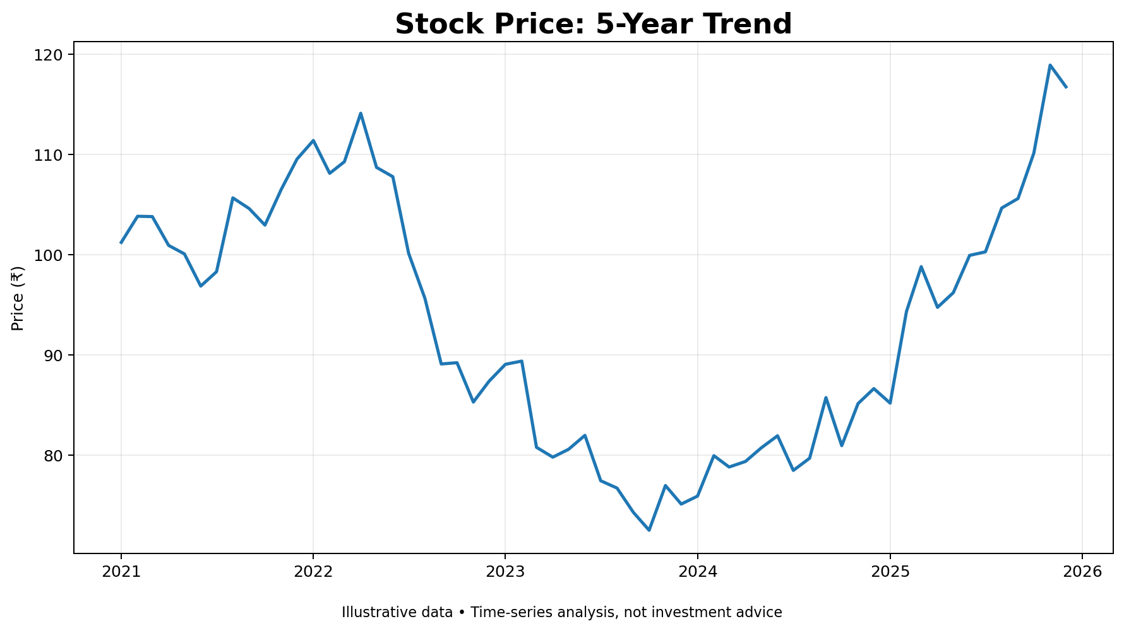
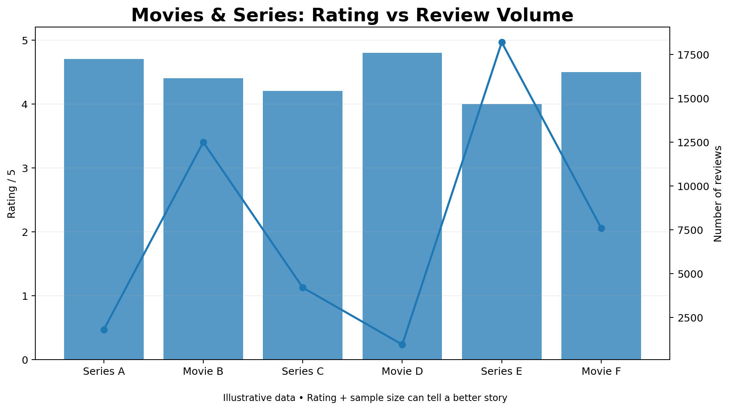
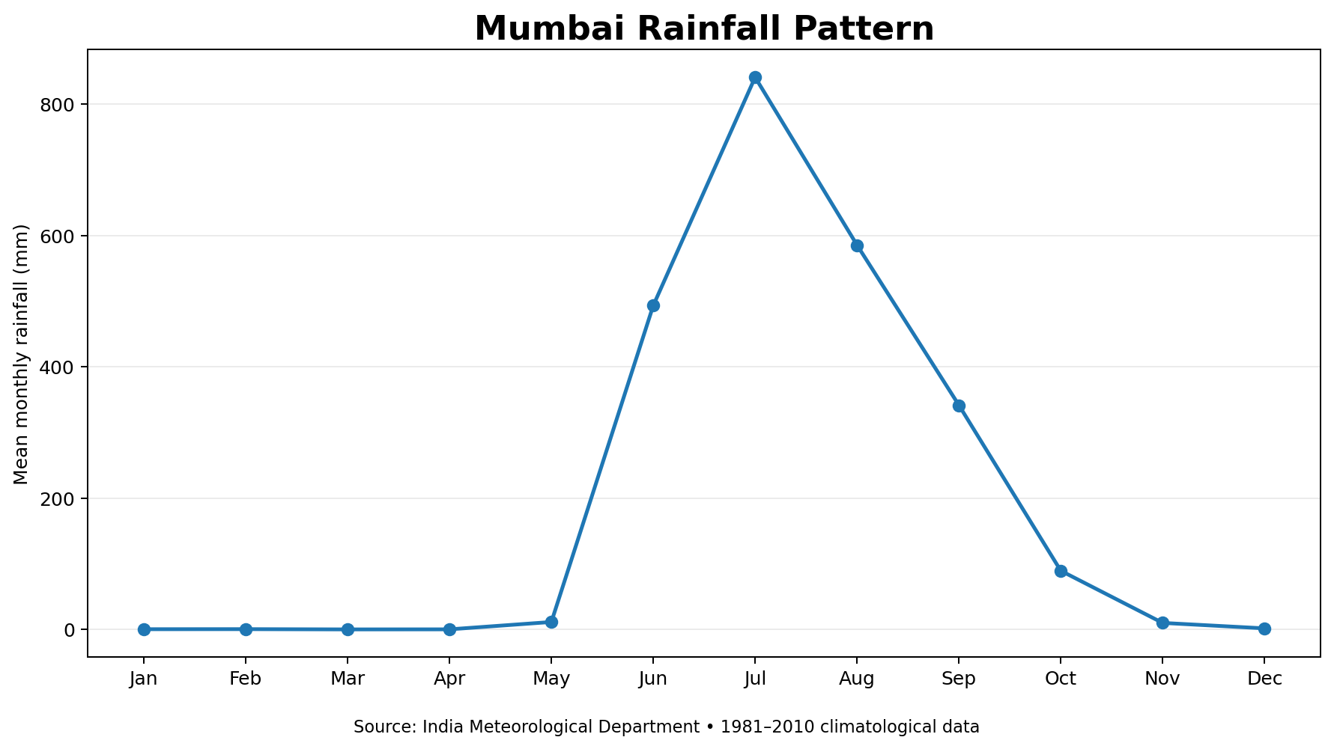
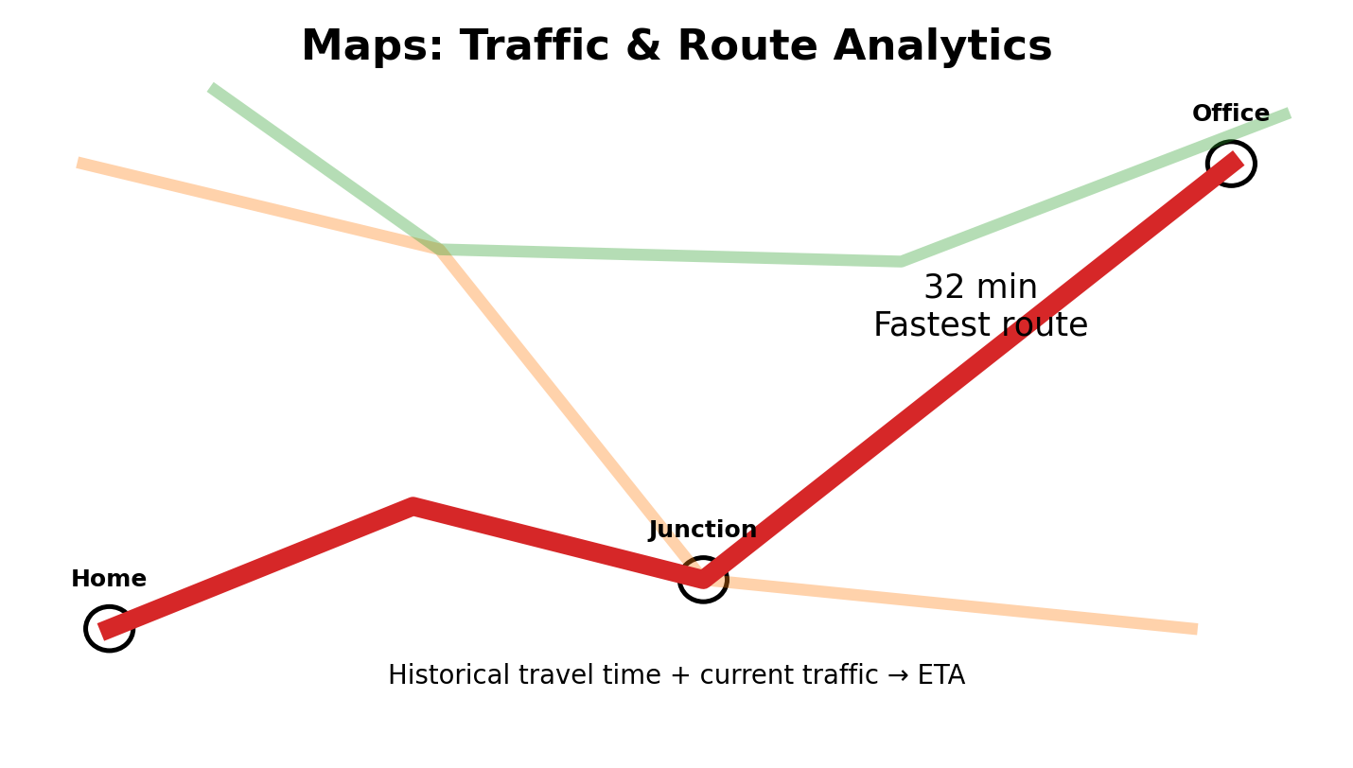

Slide 6
Data Consumers
Performance Analysis
Sentimental Analysis
Time-series Analysis
Predictive Analysis
Trend Analysis

Slide 7
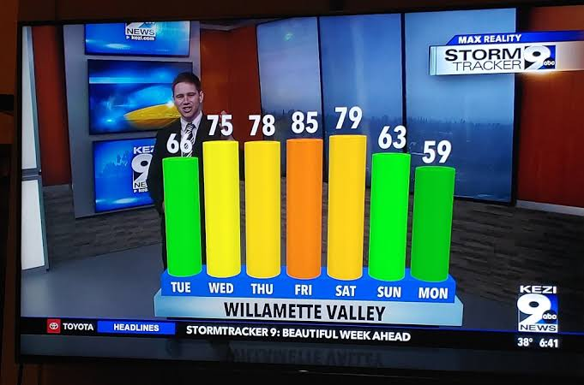
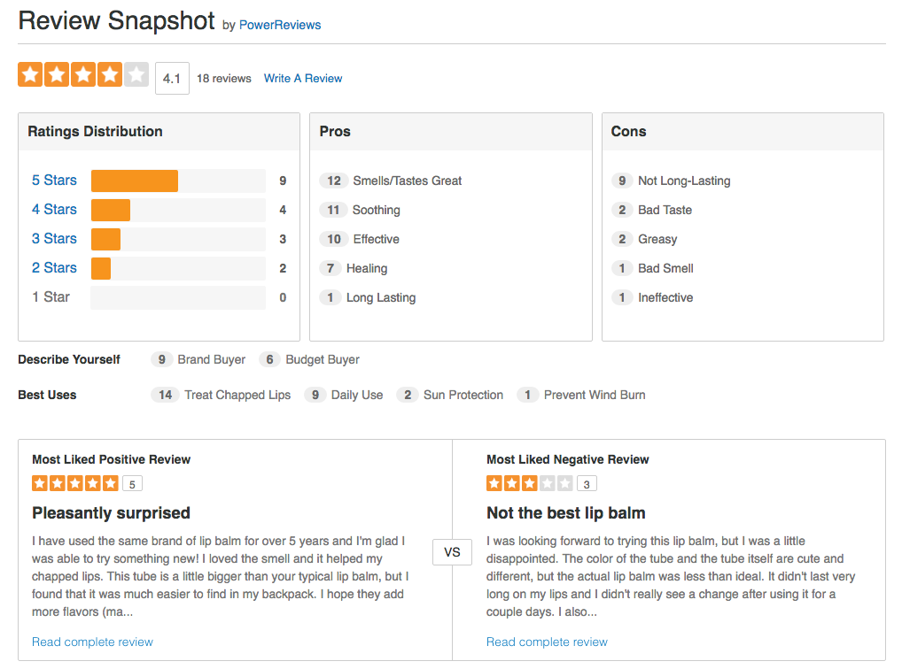
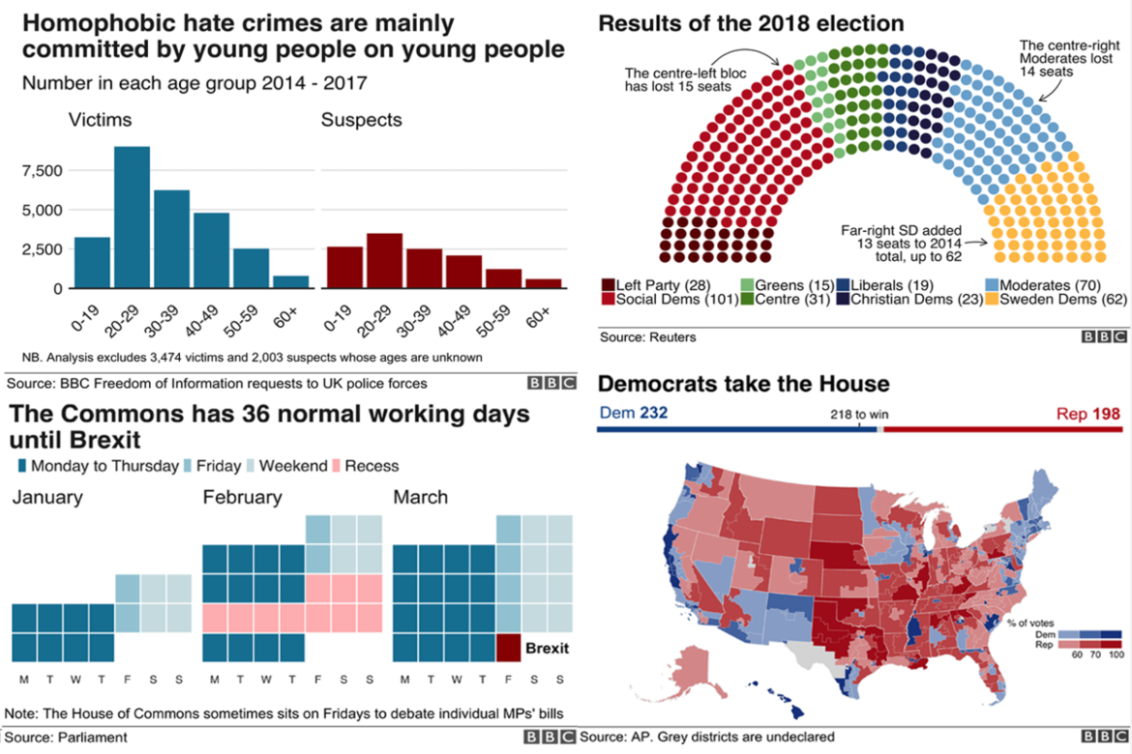
Data Sources
You are already a consumer of Data Analytics
News, Shows
Websites, Mobile Apps
Newspapers, Social Media

Slide 8
Data Output
Tables
Visuals
Ratings
Understand
Insights
Patterns
Decision
Inference
Use of Data Analysis - Consumers

Slide 9
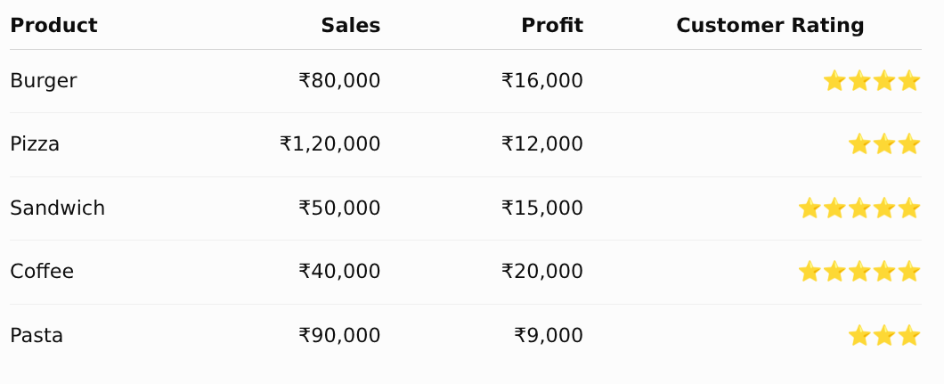
Sample Data

Slide 10
Café – Challenge
You are newly appointed - Café Manager
You have been allocated a budget
Which ONE product would you promote next month?

Slide 11
Potential Answers
Burger → strong sales
Coffee → strong profit
Sandwich → strong customer appeal
Pizza → highest revenue
So… what is the BEST decision?

Slide 12
What Additional Would You Ask For?
Associated Costs
Previous year data
Competition
Repeat customers
Events, Season
Age of customers
Delivery vs Dine-in
Location

Slide 13
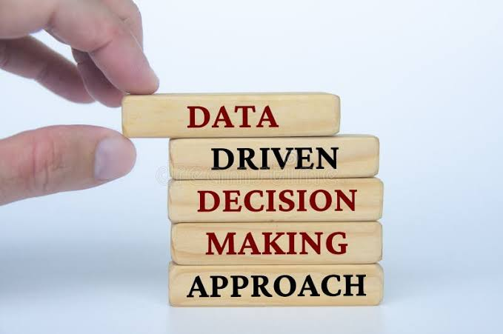

Congratulations!
You just had the Data Analyst Hat on!

Slide 14
Data Analysis Process
Raw Data
Analysis
Decision
Insight
Ask right question, find the answer hidden in the data

Slide 15
Data Analyst
Ask Right Questions
Discover Patterns
Solve
Business
Purpose
Decisions
Data Analyst => business problem solver — not just a person who makes charts.

Slide 16
Data Consumer vs Data Analyst
Data Visuals
Understand
Decision
Decision
Analysis
Raw Data
Collection
Visuals
Cleaning

Slide 17


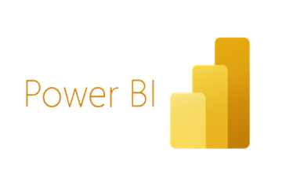
Tools
Excel → Analyse
Power BI → Visualise & Explore
AI → Accelerate & Assist
The tools are different.
The thinking is the same: Ask better questions.

Slide 18

Demo

Slide 19
Demo

Slide 20
Your Takeaway
Smart Course
Data Skills
Success Factor
(Nilaya Super 30)
Excel → Analyze
Power BI → Visualize
AI → Accelerate
Business Thinking → Decide
Smart Course – B.Com. BBA, MBA, PGDEF, CAFM, CAM, NELP

Slide 21
One Last Thought
Start with curiosity. Then learn the tools.
The best Data Analysts are not the people who know the most charts.
They are the people who ask the best questions.
9th Rank – Times B-School Survey
7th Rank – Times B-School Survey
Top 3 Rank

Slide 22
Q & A

